Slide 1
Name
Faizan

Slide 2
Intro
Name:
F name
Class

Slide 3
School name
Govt M.C.S Millat Colony Faisalabad

Slide 4
Hobby
Cricket & football etc.

Slide 5
Date of Birth
2 nov 2007

Slide 6
Education
8 class

Slide 7
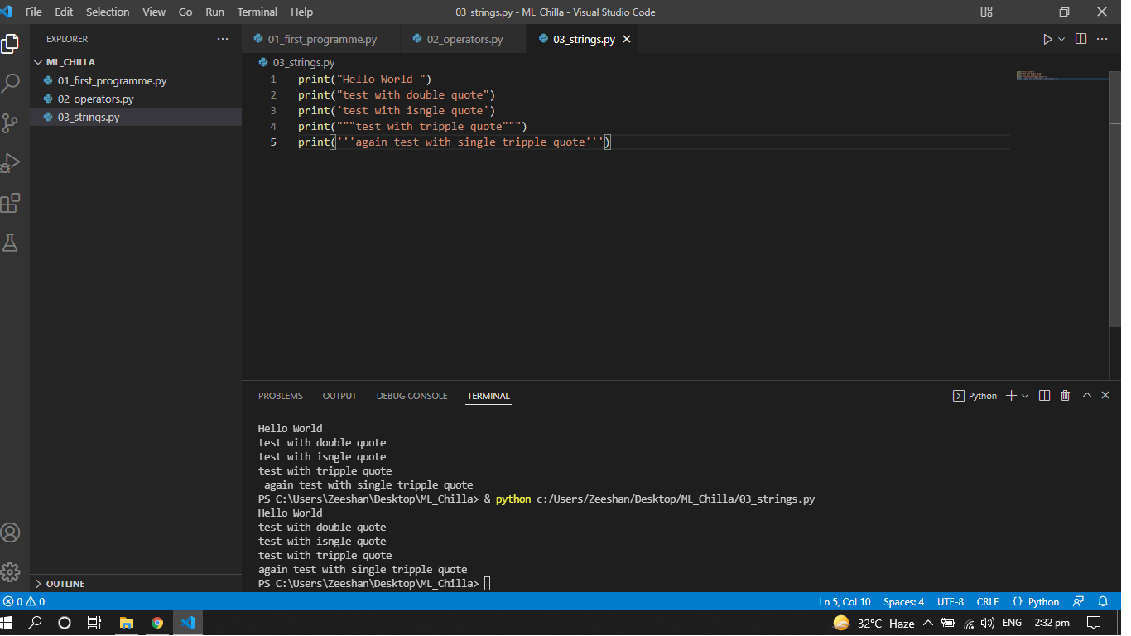

Slide 8
The End

